Slide 1
PRESENTATION FOR IOT
PROJECT PRESENTATION

Slide 2
WHAT IS THE IDEA OF THE PROJECT ?
The Smart Supermarket System is an automated solution designed to detect presence and open doors automatically, control access, detect fire, monitor gas levels and light and provide audio alerts on the flutter app. The system ensures safety and efficiency in a supermarket by utilizing the sensors and actuators, with a mobile/web interface for remote monitoring.

Slide 3
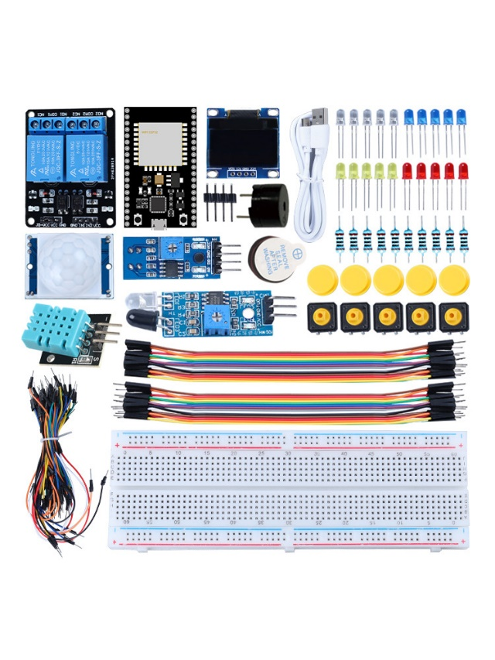
THE TOOLS WE USED:

Slide 4
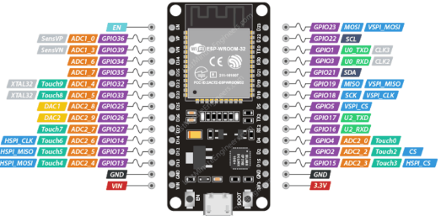
ESP32
Used FOR: Microcontroller

Slide 5

Servo Motor
Used for : the door of the supermarket

Slide 6
LDR SENSOR
Used to : Detects the light

Slide 7
MQ-4 GAS SENSOR
Uesd for : Detects the smoke and methane gas emissions

Slide 8
THE FLAME SENSOR
Used to :Detect fires or flames within the proximity of the sensor

Slide 9
BUZZER
Used to : triggers alerts as soon as the sensors detect something.

Slide 10
LCD SCREEN
Used to : Display texts and outputs and various sensor readings.

Slide 11
BREADBOARD
Used to : Connect the sensors and devices to it and putting circuits whether they are connected in parallel or series.

Slide 12
FLUTTER
Used to : create a mobile app for the users to interact with

Slide 13
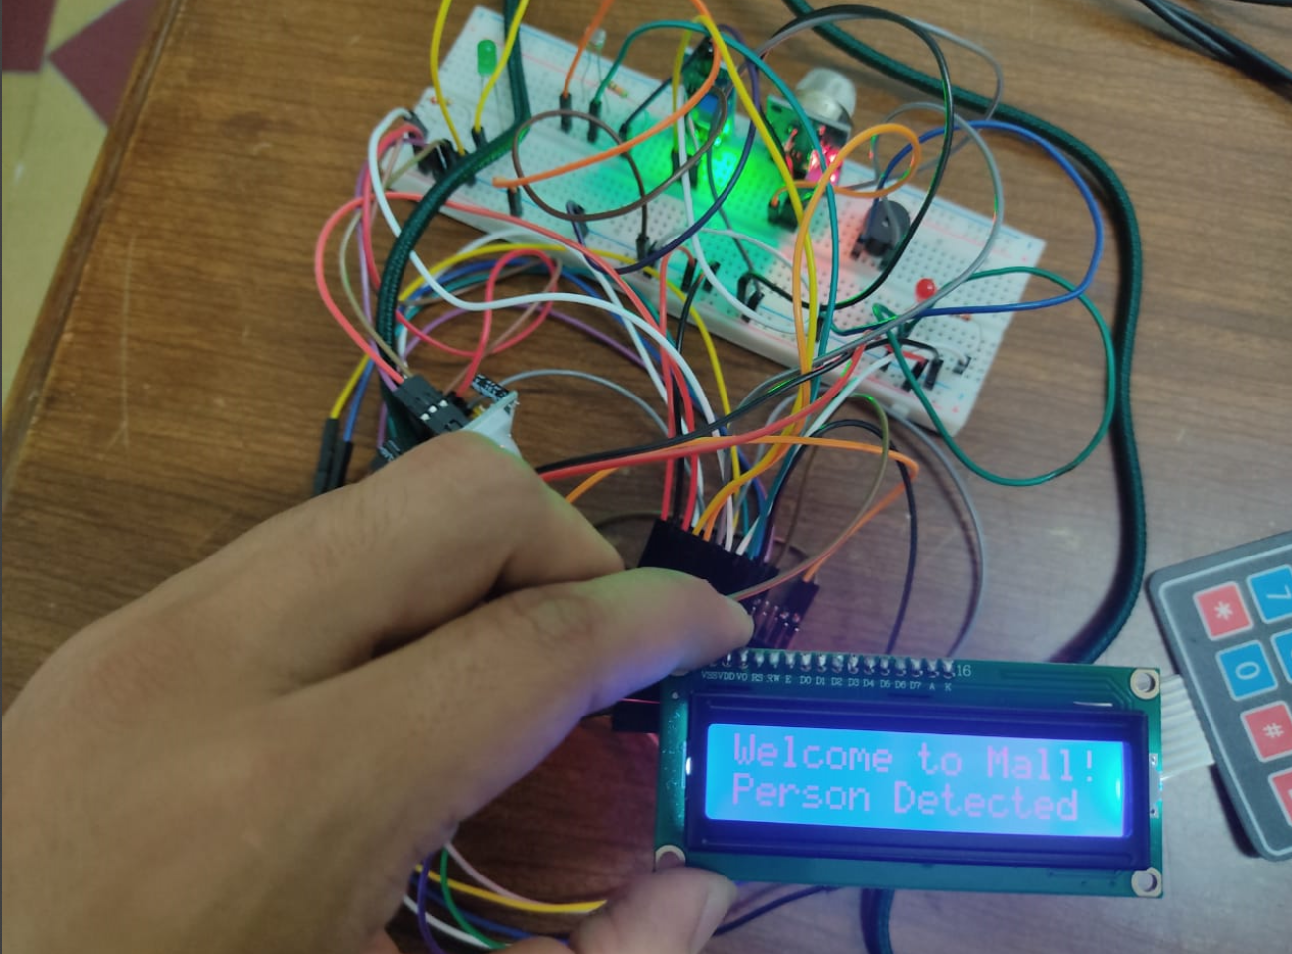
PROJECT COMPONENTS PICTURE:

Slide 14
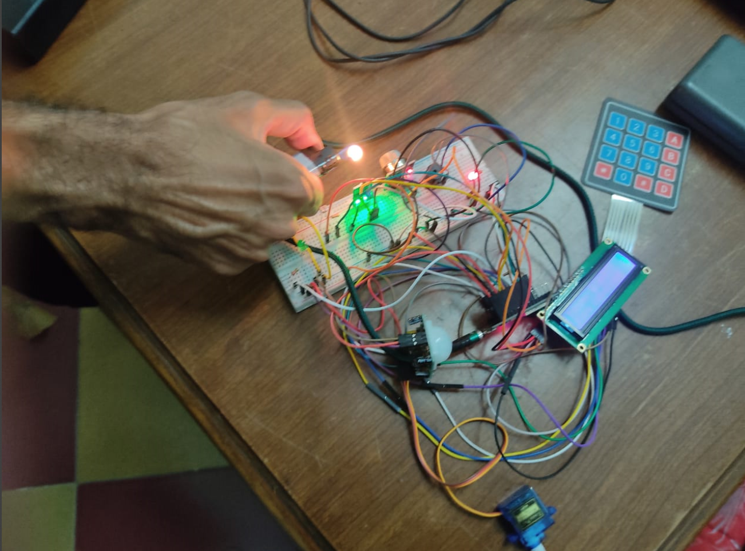
TESTING THE FLAME SENSOR:

Slide 15
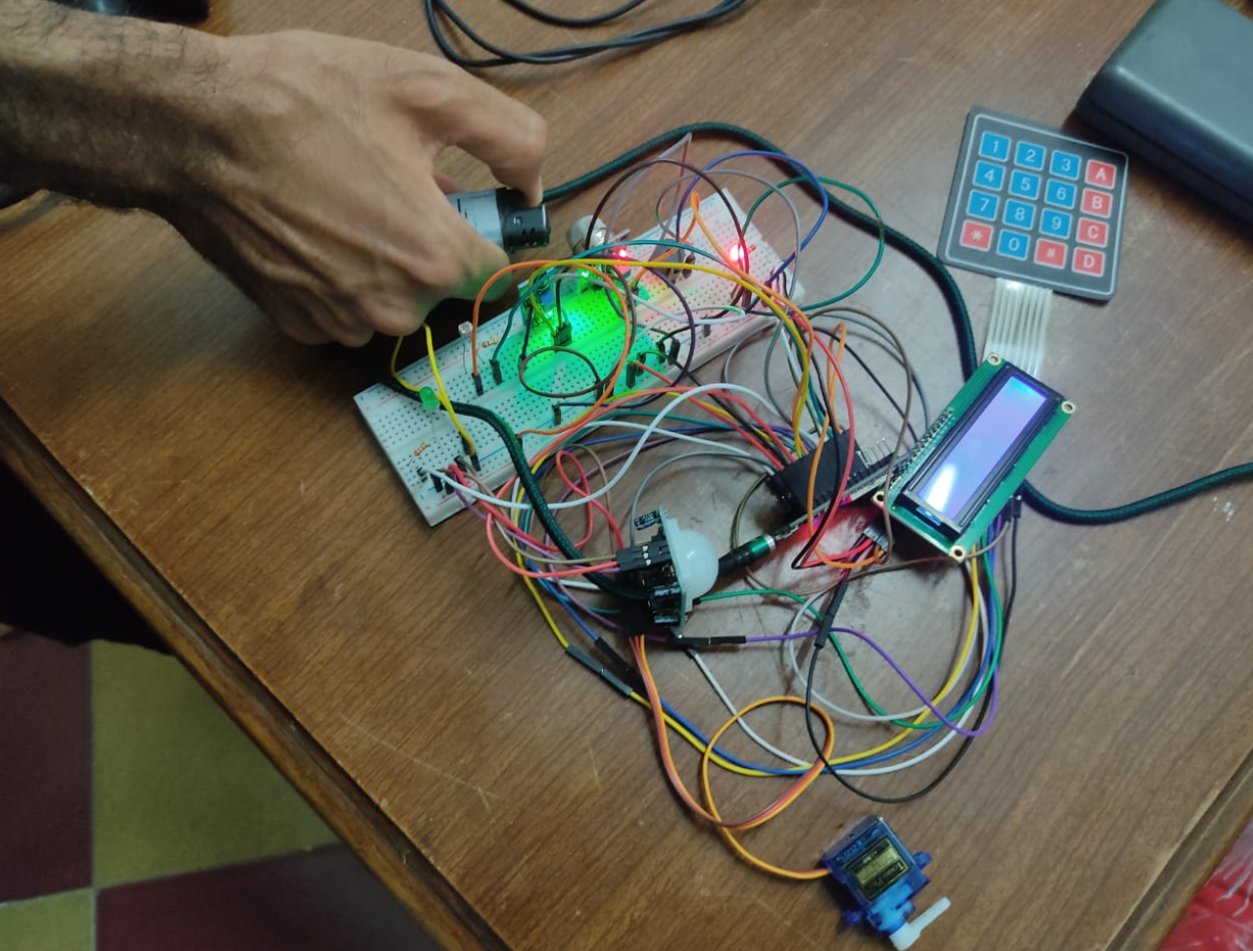
TESTING THE MQ4 SENSOR:

